Slide 1


CREDIT-PROFILE ANALYSIS (FOR TWO-WHEELER LOANS)
CAPSTONE PRESENTATION

Slide 2
Batch details | PGPDSE-FT Gurgaon Apr'23
Team members | Balvinder Singh , Aasim Mirza , Ankit Kumar , Aryan Vats , Riya Soni
Domain of Project | Financial Services and Credit Assessment
Proposed project title | Credit-Profile Analysis (for Two-Wheeler Loans)
Group Number | 5
Team Leader | Balvinder Singh
Mentor Name | Animesh Tiwari

Slide 3


PHASE- ONE
BUSINESS UNDERSTANING
INTRODUCTION TO THE PROBLEM & BACKGROUND DETAILS:
The problem at hand revolves around the efficient and responsible assessment of the creditworthiness of individuals applying for two-wheeler loans in India. Can we develop a robust machine learning model that accurately evaluates the credit profiles of two-wheeler loan applicants, enabling lending institutions to make informed and ethical lending decisions, while ensuring fairness and adherence to regulatory standards?

Slide 4
BUSINESS PROBLEM AND ITS IMPACTS
Business problem: To figure out if someone is a good fit for a loan or not.
Impact on Business: Market Growth: If banks can figure out who is a good fit for loans, they can lend more money and make more profit.
Risk Mitigation: Banks want to avoid giving loans to people who might not pay them back.
Financial Inclusion: This means giving loans to more people, especially those who didn 't have the chance before. It helps more people buy two-wheelers and improve their lives.
Fairness and Trust: Banks want to be fair and not treat people differently because of things like where they ' re from or what they look like. Being fair and trustworthy helps them build a good reputation. Why do we need to solve this problem?
Market Demand: Lots of people want two-wheeler loans in India. Banks need a way to help them and make more money. Ethical Lending: Banks want to lend money fairly and responsibly.
Data-Driven Decisions: Banks want to use data and information to make smart choices.

Slide 5


PHASE- TWO
DATA UNDERSTANDING
UNDERSTANDING THE DATA IS VERY IMPORTANT WITH RESPECT TO BUSINESS UNDERSTANDING.
Data Overview
Dataset Shape: 100,000 rows x 15 columns
Columns and Data Types
Columns: Age, Gender, Income, Credit Score, Credit History Length, Number of Existing Loans, Loan Amount, Loan Tenure, Existing Customer, State, City, LTV Ratio, Employment Profile, Profile Score, Occupation
Data Types:
Numeric: int64 (8 columns), float64 (1 column)
Categorical: object (6 columns)
Missing Values
Occupation column has missing values
Under Occupation column, 6% of the data is missing

Slide 6
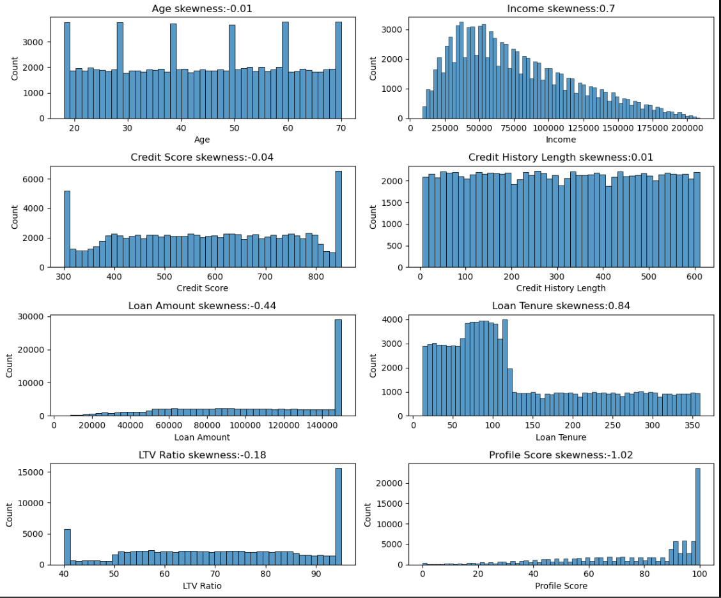
DATA UNDERSTANDING UNIVARIATE ANALYSIS
Inferences from data distribution:-
Age- Age column is approximately uniformly distributed
Income- Income column is rightly skewed
Credit Score- Uniformly distributed
Credit History Length- Uniformly distributed
Loan Amount- Left skewed
Loan Tenure- Right skewed
LTV Ratio-Left skewed
Profile Score- Left skewed

Slide 7
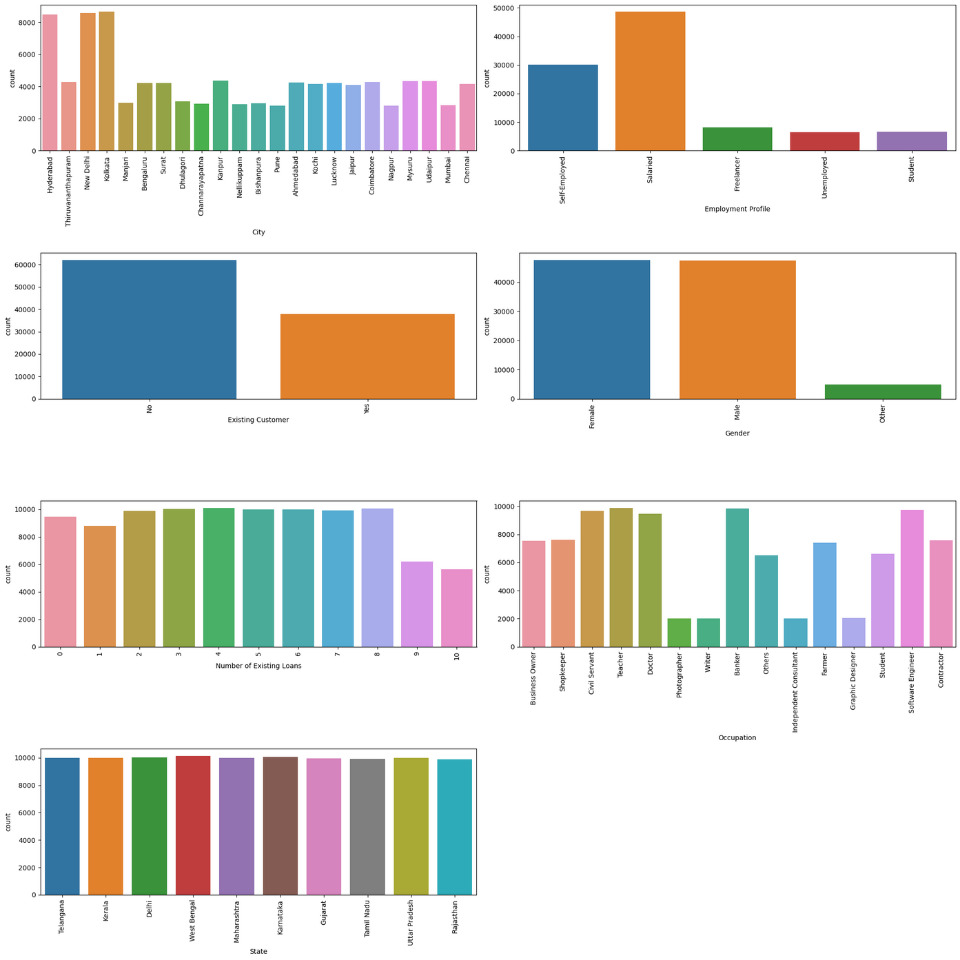
UNIVARIATE ANALYSIS
Inferences from Bar Plots:-
City- Hyderabad, New Delhi and Kolkata has highest count
Employment Profile- Salaried>Self employed> Freelancer>Unemployed and Student
Existing Customer- No has the highest count
Gender- Male and Female has almost similar count and more than others
Number of Existing Loans- 2-8 has the highest count
Occupation- Civil Services, Teacher, Doctor, Banker and software engineer has highest count
State- All states have similar counts

Slide 8
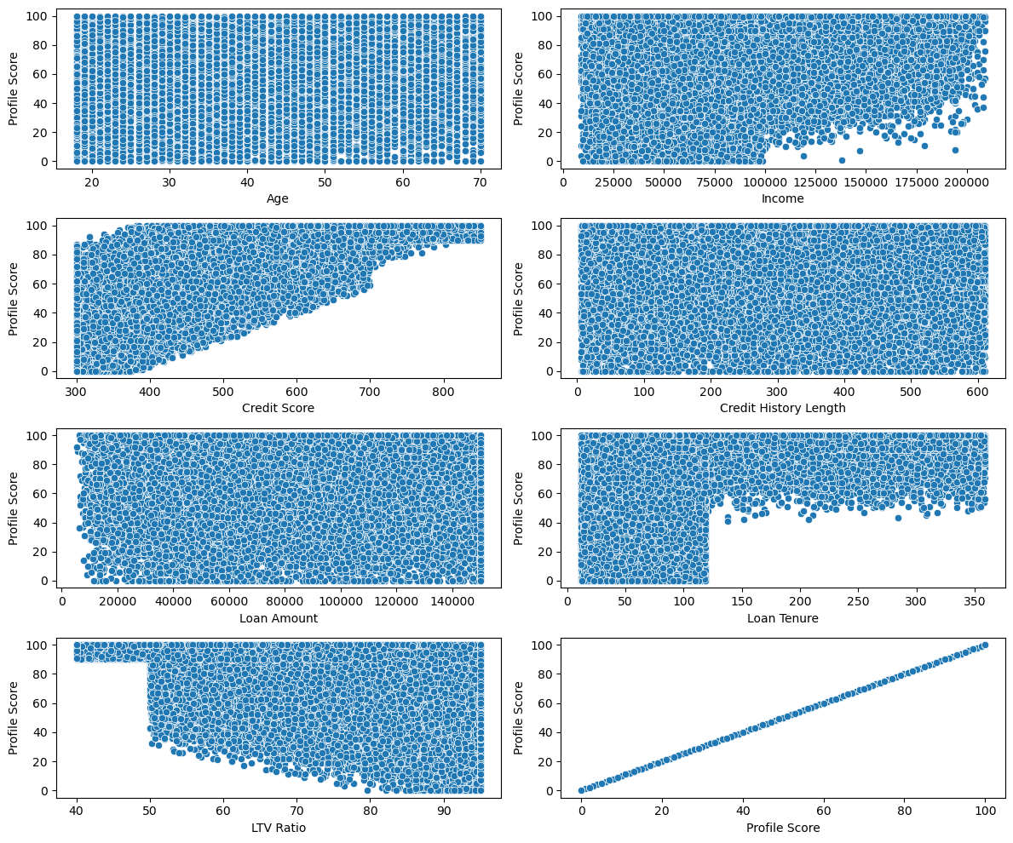
BIVARIATE ANALYSIS
NUM VS TARGET
Inferences from Scatter plots:-As all the data points are uniformly distributed. Therefore, there is no such significant relation between Number and targert column.

Slide 9
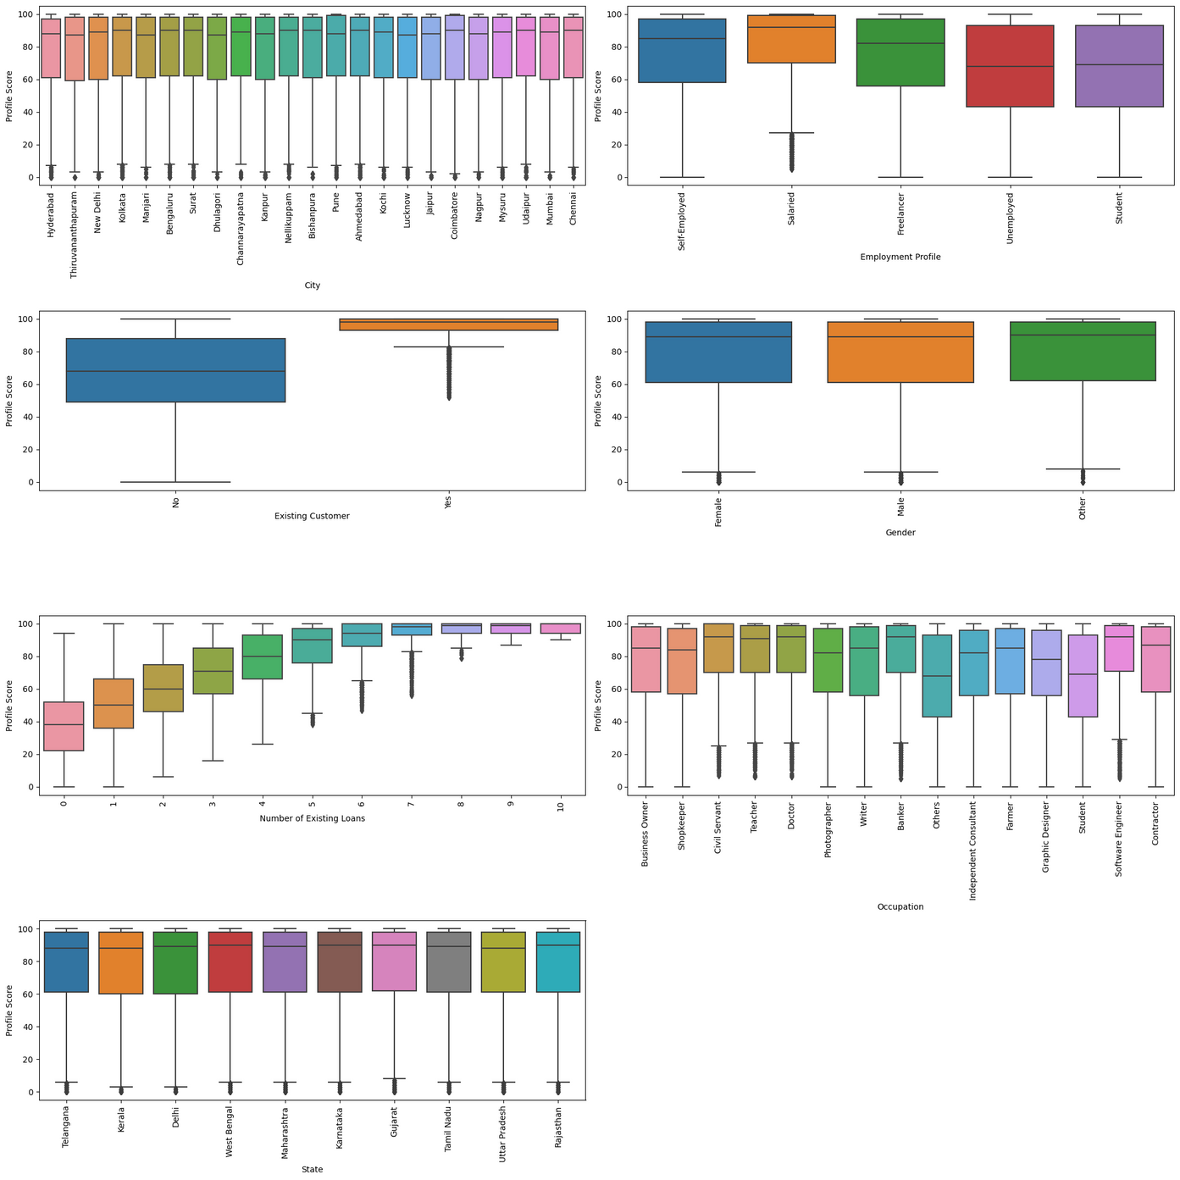
BIVARIATE ANALYSIS
CATEGORY VS TARGET
Inferences from BOX Plots
City-Profile scores for all cities are approximately the same.No significant variations observed in Profile Scores across different cities.
Employment Profile-Salaried employees exhibit the highest Profile Scores.Other employment profiles show varying scores but not as high as the salaried category.
Existing Customer-Profile scores for existing customers are higher compared to non-existing customers.Indicates a positive correlation between existing customer status and profile score.
Gender-Profile scores for all genders are similar.No significant disparity observed in profile scores based on gender.
Number of Existing Loans-Individuals with 9 and 10 existing loans tend to have the highest Profile Scores.
Occupation-Others and Students occupations have the lowest Profile Scores.Other occupations vary but generally have higher profile scores compared to these categories.
State-All states display similar Profile Scores.No notable differences observed in profile scores based on the state of residence.

Slide 10
PHASE - THREE
DATA PREPERATION
1. Correcting State Names based on City
2. Grouping and Checking State Distribution
3. Grouping States into Zones
4. Employment Profile and Occupation Analysis
5. EMI Calculation
6. City Analysis
7.Handling & Imputation of Missing Values in dataset
8.Encoding the Categorical columns
Zones- Label Encoding (East-0 West-1 North-2 South-3)
City- Catboost Encoding
Employment profile- Catboost Encoding
Occupation- Catboost Encoding
Existing Customer- Label Encoding (No-0, Yes-1)
Gender- Label Encoding (Other-0, Male-1, Female-2)

Slide 11
PHASE - THREE
STATISTICAL TESTING
Normality Test:
Applied Shapiro-Wilk Test for normality.
Inference: P-values < 0.05, data is not normal.
Equality of Variance:
Conducted Levene's Test for variance equality.
Inference: P-values < 0.05, variance conditions not met.
Mann-Whitney U Test.
Inference: Significant relation between all numerical variables and the target (Profile Score).
Kruskal-Wallis Test.
Inference: Except for Zone and Gender, all other categorical variables show a significant relation with the target (Profile Score).
Conclusion
The dataset doesn't meet normality and variance equality assumptions for numerical variables.
Mann-Whitney U Test and Kruskal-Wallis Test reveal significant relations for both numerical and categorical variables with the target (Profile Score).
Further analysis and modeling may consider non-parametric approaches due to the violated assumptions.

Slide 12

PHASE-FOUR
DATA MODELLING
BASE-MODEL

Slide 13
PHASE - FOUR
ASSUMPTIONS CHECK FOR LINEAR REGRESSION
1. Multicollinearity
VIF (Variance Inflation Factor) Analysis:
Multicollinearity detected in the columns.
Drop Credit Score and Age due to high VIF.
2. Linearity: Rainbow Test:
P-value > 0.05.
Inference: Fail to reject Ho, indicating the model is linear.
3. Autocorrelation of Errors: Durbin-Watson Test:
Durbin-Watson number: 2.004.
Inference: No autocorrelation in the dataset.
4. Homoskedasticity: Residual Plot
Residuals increase with the profile, indicating heteroskedasticity.
Fails to meet the homoskedasticity assumption in Linear Model.
5. Normality of Residuals: Jarque-Bera Test
P-value < 0.05.
Inference: Reject Ho, residuals are not normal.

Slide 14
MODEL BUILDING :LINEAR REGRESSION (BASE MODEL)
Data Preparation:
Utilized the Statsmodels and Scikit-learn libraries for model development.
Segmented the dataset into training (80%) and testing (20%) sets.
Segmented the dataset into predictor variables (x) and the target variable (y).
Utilized the train_test_split function to create training and testing sets with a 80-20 split ratio.
Explored the structure of the training set (xtrain).
Data Split Information:
Training set size: 80,000 rows and 15 columns.
Testing set size: 20,000 rows and 15 columns.
Model Building:
Applied Ordinary Least Squares (OLS) Regression for the base model.
Formed the design matrix by dropping the target variable 'Profile Score' from the feature set.
Used the sm.add_constant function to add a constant term to the design matrix.
Fit an OLS regression model using the training set.

Slide 15
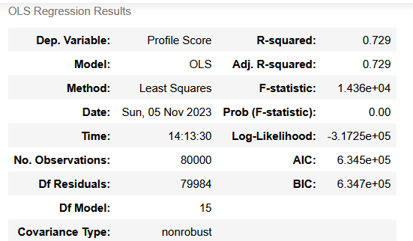
PHASE - FOUR
MODEL EVALUATION
Model Summary (OLS Regression):
Achieved an R-squared value of 0.729, indicating a moderate level of explanatory power.
Significant predictors include 'Credit Score,' 'Number of Existing Loans,' 'Loan Tenure,' 'Existing Customer,' 'Zone,' 'LTV Ratio,' 'Employment Profile,' and 'Occupation.'
Some predictors like 'Age,' 'Gender,' 'Credit History Length,' 'Loan Amount,' 'City,' and 'EMI_per_Month' show less significance.
OLS Regression Results provided detailed statistics.
Key Metrics:
R-squared: 0.729
Adjusted R-squared: 0.729
F-statistic: 1.436e+04
The model shows a reasonable fit with a moderate R-squared value.
Coefficients provide insights into the impact of predictors on the target variable.
Possible multicollinearity issues indicated by a large condition number.

Slide 16
PHASE - FOUR
EVALUATING OTHER MODELS
1. Decision Tree Regressor
Hyperparameter Tuning using Grid Search:
Best Parameters: {'max_depth': 9}
Model Performance
Training R² Score: 0.8816
Training RMSE: 8.44
Testing R² Score: 0.8659
Testing RMSE: 8.94
Inference
Decision Tree Regressor is a strong model for the problem.
High R² scores (0.8816 and 0.8659) indicate good variance capture.
Low RMSE values suggest accurate predictions.

Slide 17
PHASE - FOUR
EVALUATING OTHER MODELS
2. Gradient Boosting Regressor
Hyperparameter Tuning using Grid Search:
Best Parameter: {‘Learning_rate': 0.2}
Model Performance
Training R² Score: 0.874
Training RMSE: 8.71
Testing R² Score: 0.870
Testing RMSE: 8.81
Overall Inference
Gradient Boosting Regressor shows high performance.
Comparable R² scores and low RMSE values between training and testing sets indicate good generalization.
A robust model demonstrating effectiveness on both datasets.
Conclusion
Decision Tree and Gradient Boosting Regressor showcase promising results.
Detailed analysis and iterative refinement will be crucial for model enhancement.
Both the training and testing R² scores are high, suggesting that the Gradient Boosting Regressor and Decision Tree Regressor is effective at explaining the variance in both the training and testing datasets.
The RMSE values for both training and testing sets are relatively low, indicating that the model's predictions are, on average, close to the actual values in both datasets.
Considerations:
The R² scores and RMSE values are quite comparable between the training and testing sets, suggesting good generalization.
The Gradient Boosting Regressor and Decision Tree Regressor appears to be a robust model for the given problem, demonstrating high performance on both the training and testing datasets.

Slide 18
THANK YOU

